Slide 1
Phase I
Wellness Manager

Slide 2
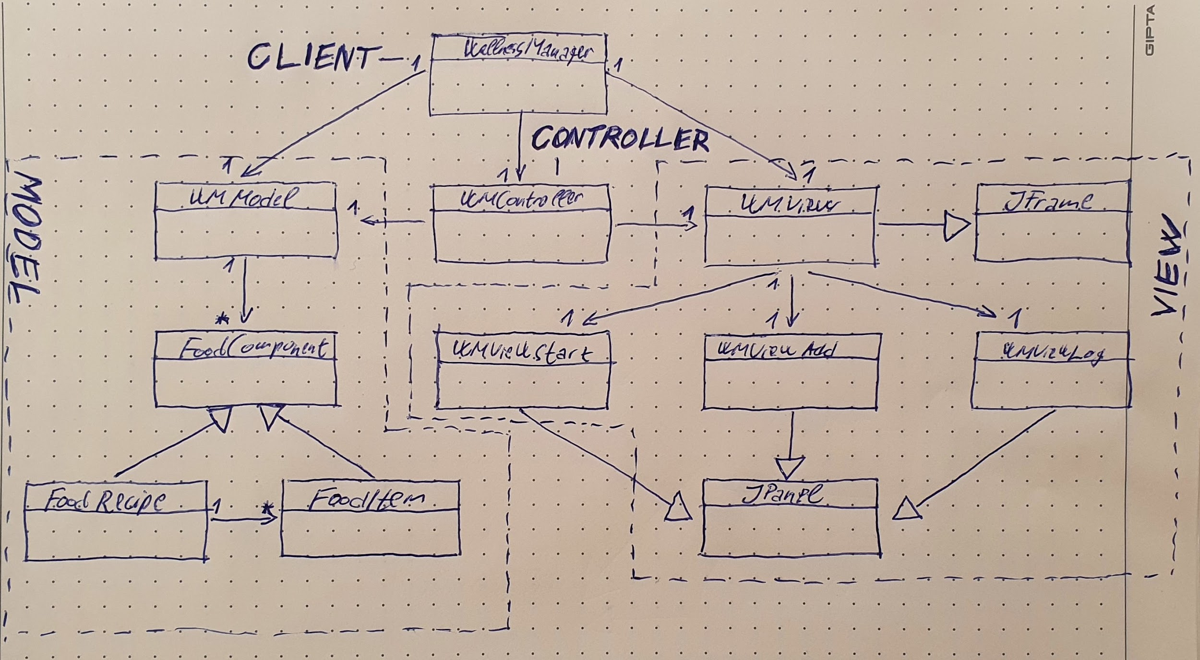

Slide 3
MVC

Slide 5
Composite

Slide 7
Dependency Injection

Slide 9
Facade

Slide 11
Observer

Slide 13
Shortcomings

Slide 14
Thank you for your attention

